Slide 1
Nikolett Jakša 403/22
EUGLOH
LET’S TALK

Slide 2
WHAT’S EUGLOH?
European University Alliance for Global Health
Strategic partnership between 9 universities
Developing interdisciplinary activities, particularly in education and training
Focusing on well-being and public health

Slide 3
CULTURES AND TRADITIONS
PROCEDURE
FINAL PROJECT
We spoke on Google Meet
We made a poem about intercultural conncetions
1
2
3
4
TASK
TOPICS
Getting to know each other and being able to communicate between cultures
Culture, cuisine, language, etc.

Slide 4
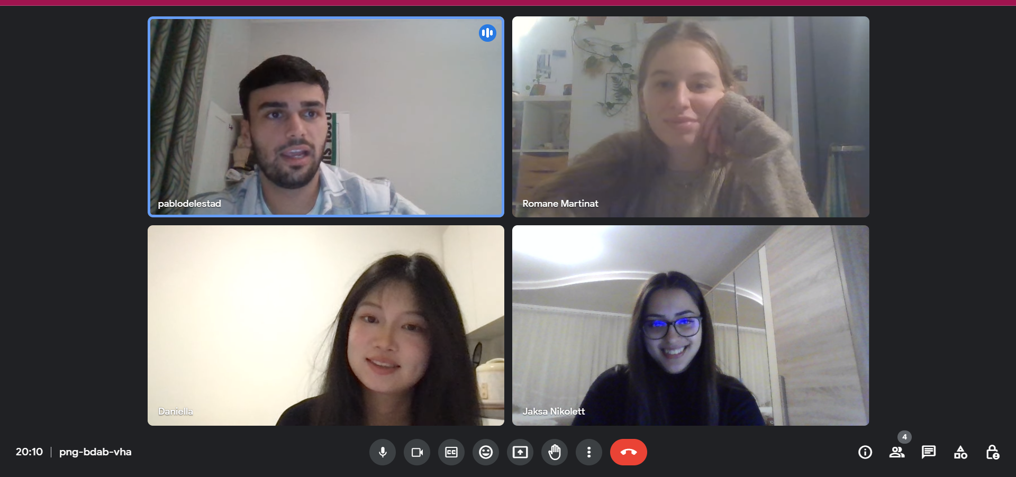
MEMBERS OF OUR GROUP
During one of our meetings...
Spain
France
Pablo del Estad Yélamos
Romane Martinat
China
Serbia
Danyi Wang
Nikolett Jaksa

Slide 5
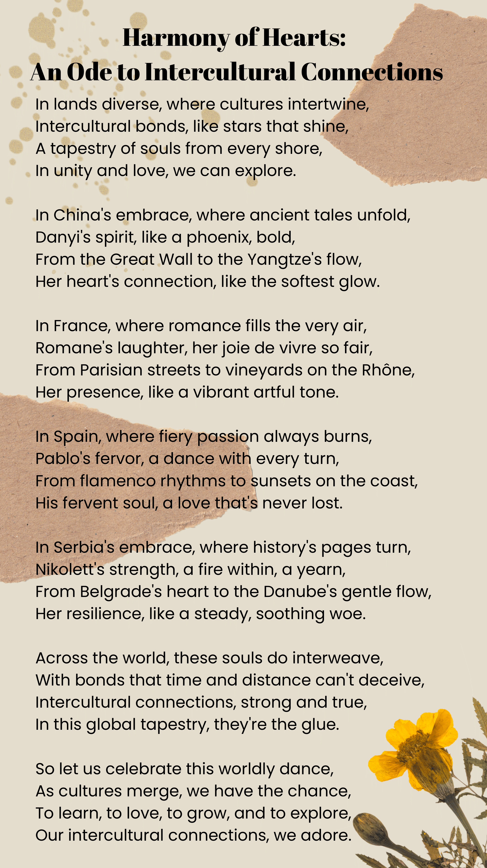
FINAL PROJECT
We made a poem about intercultural connections, we mentioned everyone’s name and country. We named the poem „Harmony of Hearts: An Ode To Intercultural Connections”

Slide 6
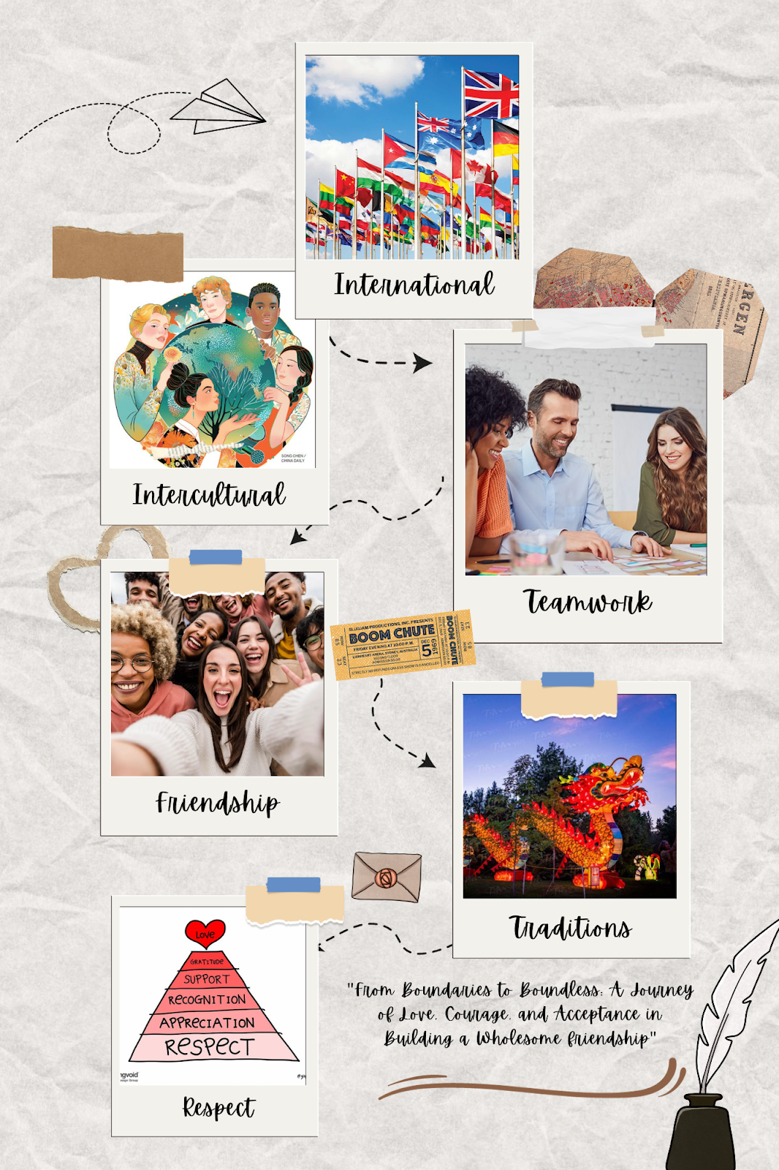
PHOTO COLLAGE
We had to make a photo collage about what unites us and which values we share.

Slide 7
MY EXPERIENCES
BENEFITS
CHALLENGES
RESOLUTION
I improved my communication skills and learned a lot about other people’s cultures.
Sometimes we didn’t understand each other well
We changed our communication styles

Slide 8
I LEARNED...
IDEAS
COMMUNICATION
PATIENCE
...how to think creatively.
...how to be more confident speaking English.
...to show more respect to other cultures.

Slide 9
THANK YOU!

